Slide 1
Weekly Update
Jorian Bruslind
Week 8

Slide 2
HyperRail Project
Current Status
Helping Junior Design students debug systems
ESP32 board level debug
PCB design reviews
Schematic layout and design review
Finding areas where the STEMbassadors can help out
Waterproof motor mounts / shrouds
Better ways to create linear motion
More research into cable parallel robots

Slide 3
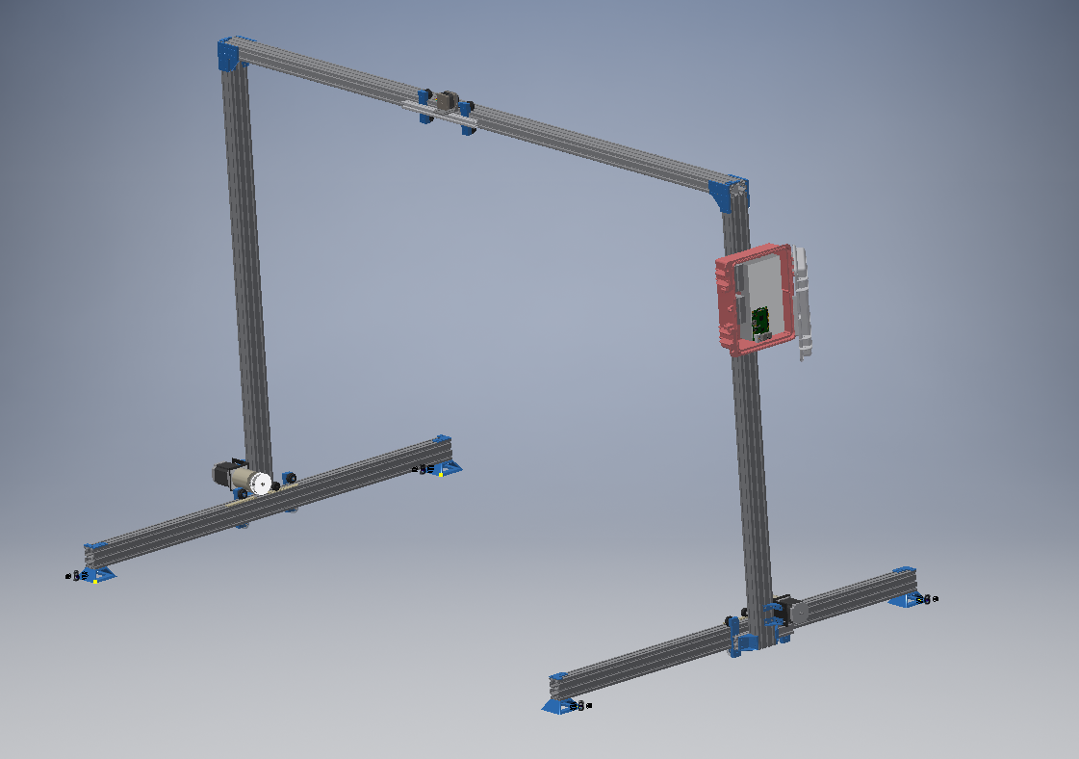
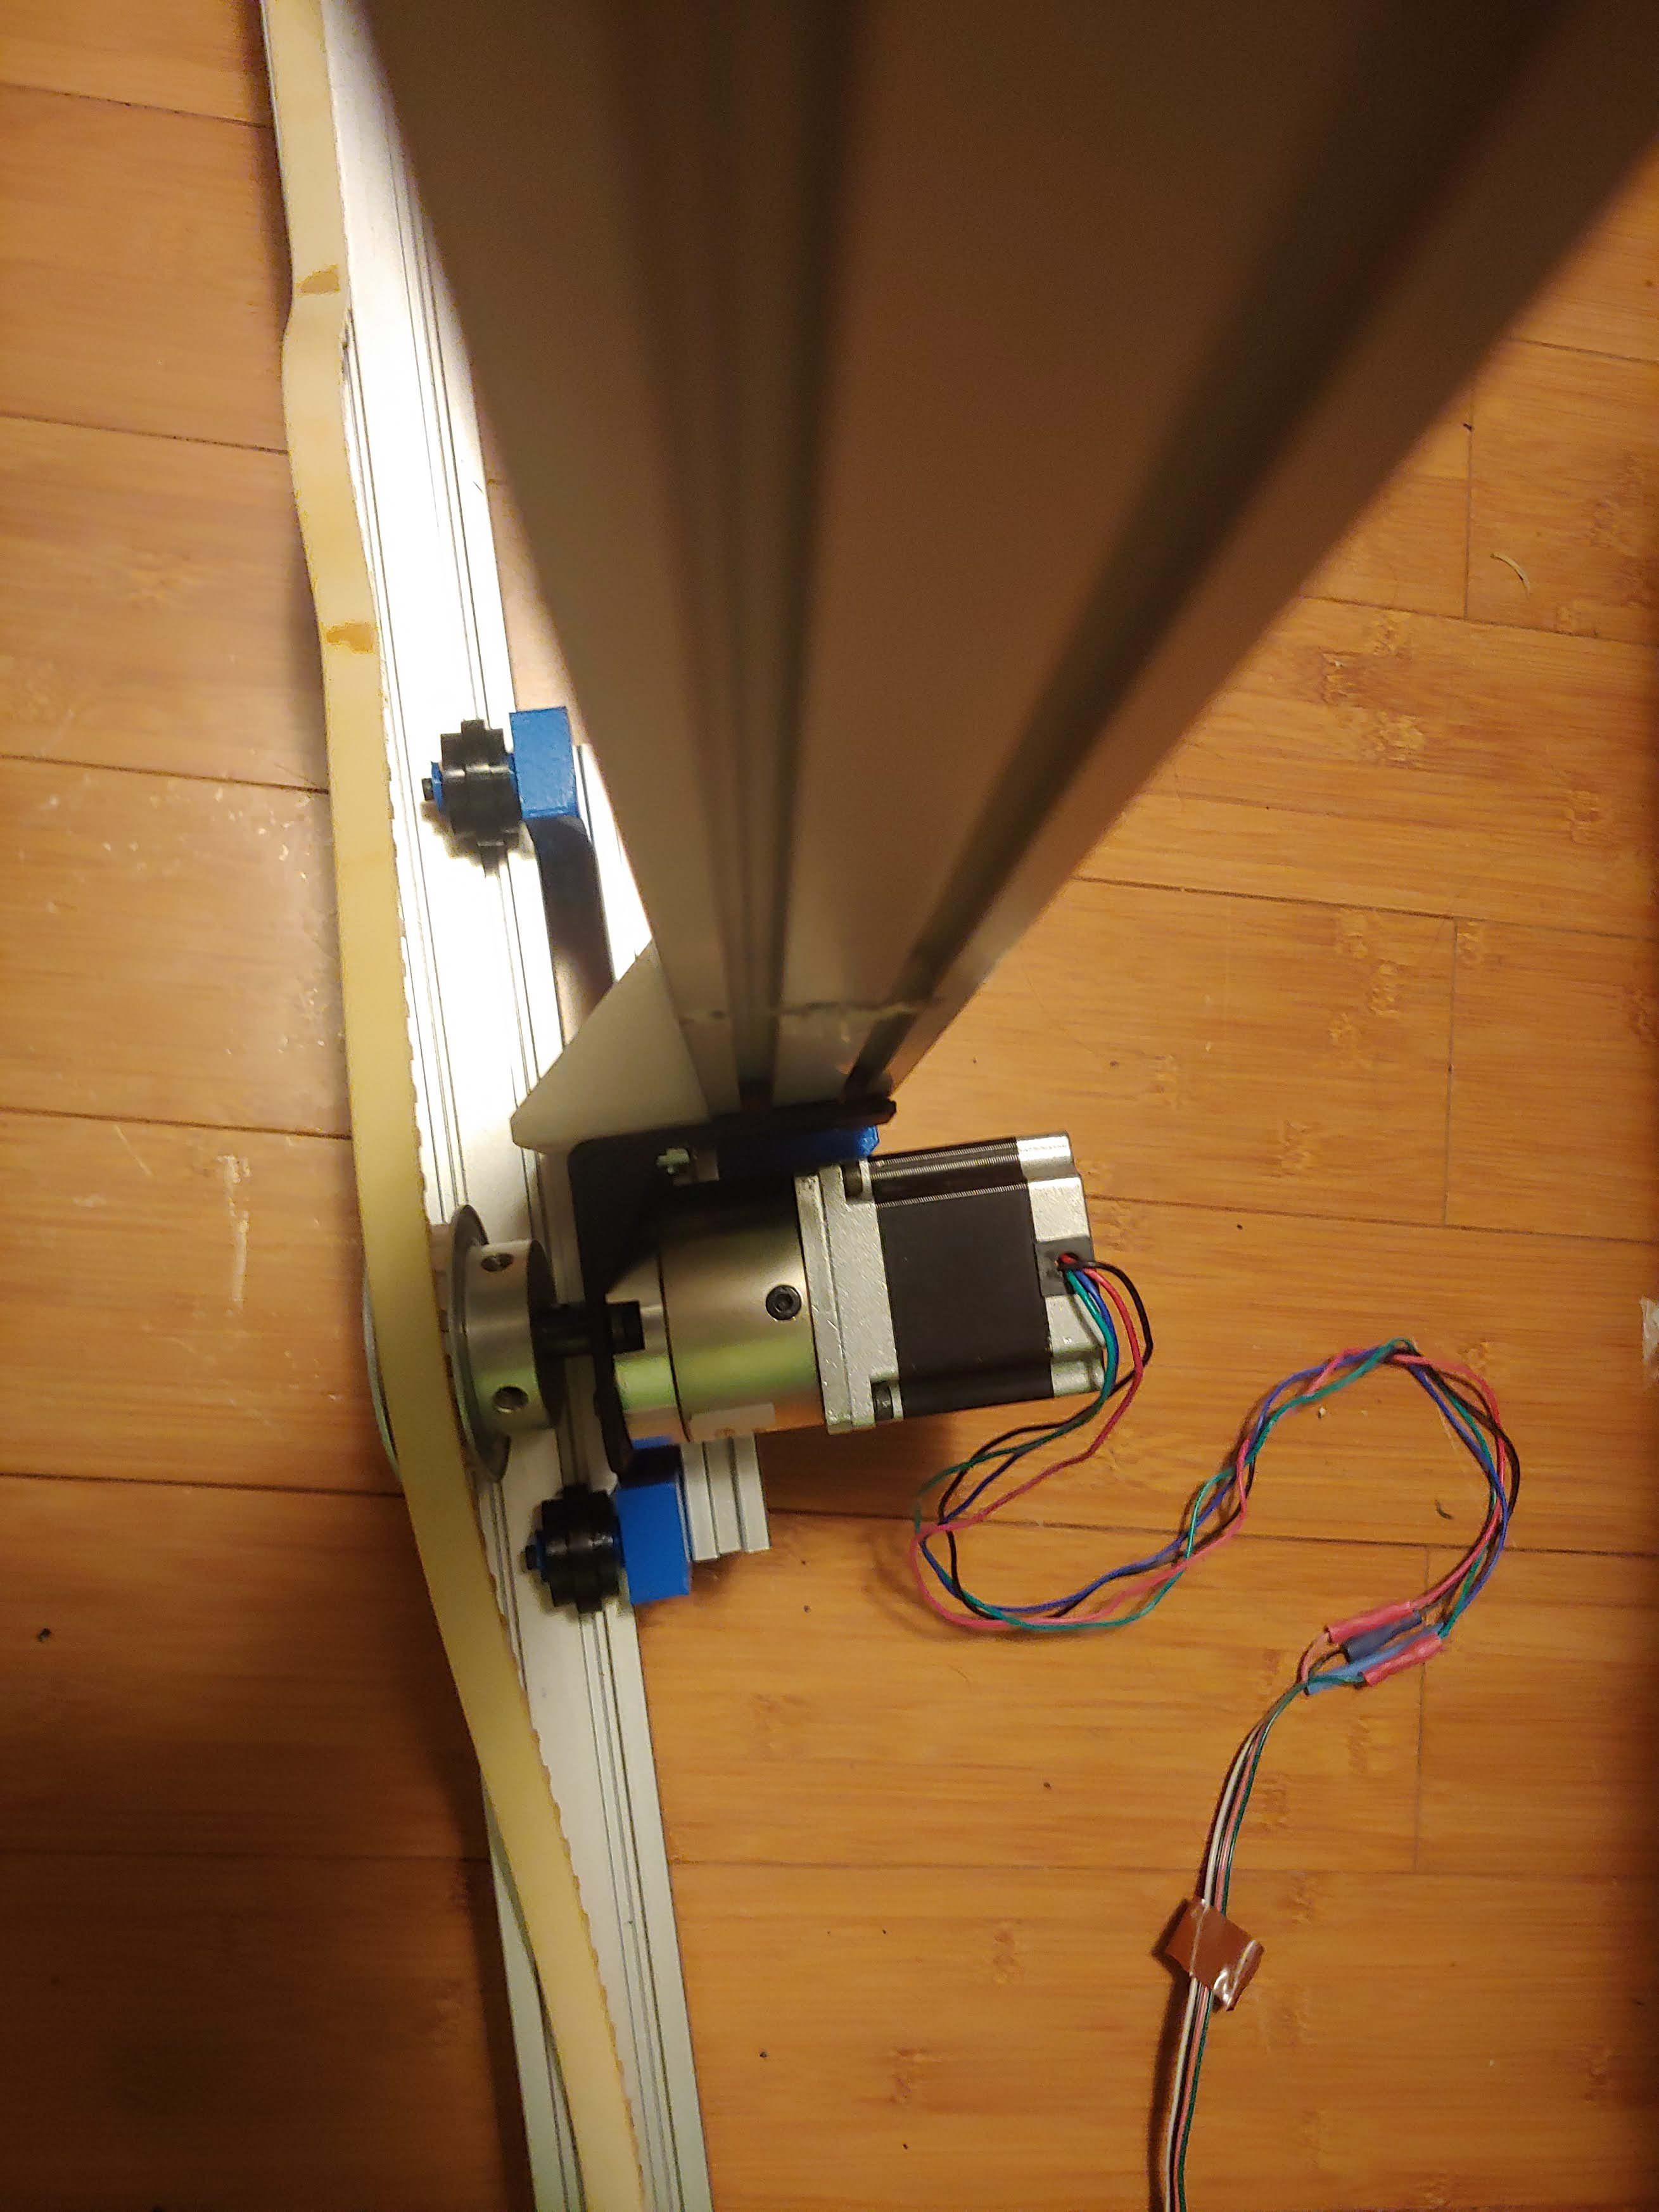
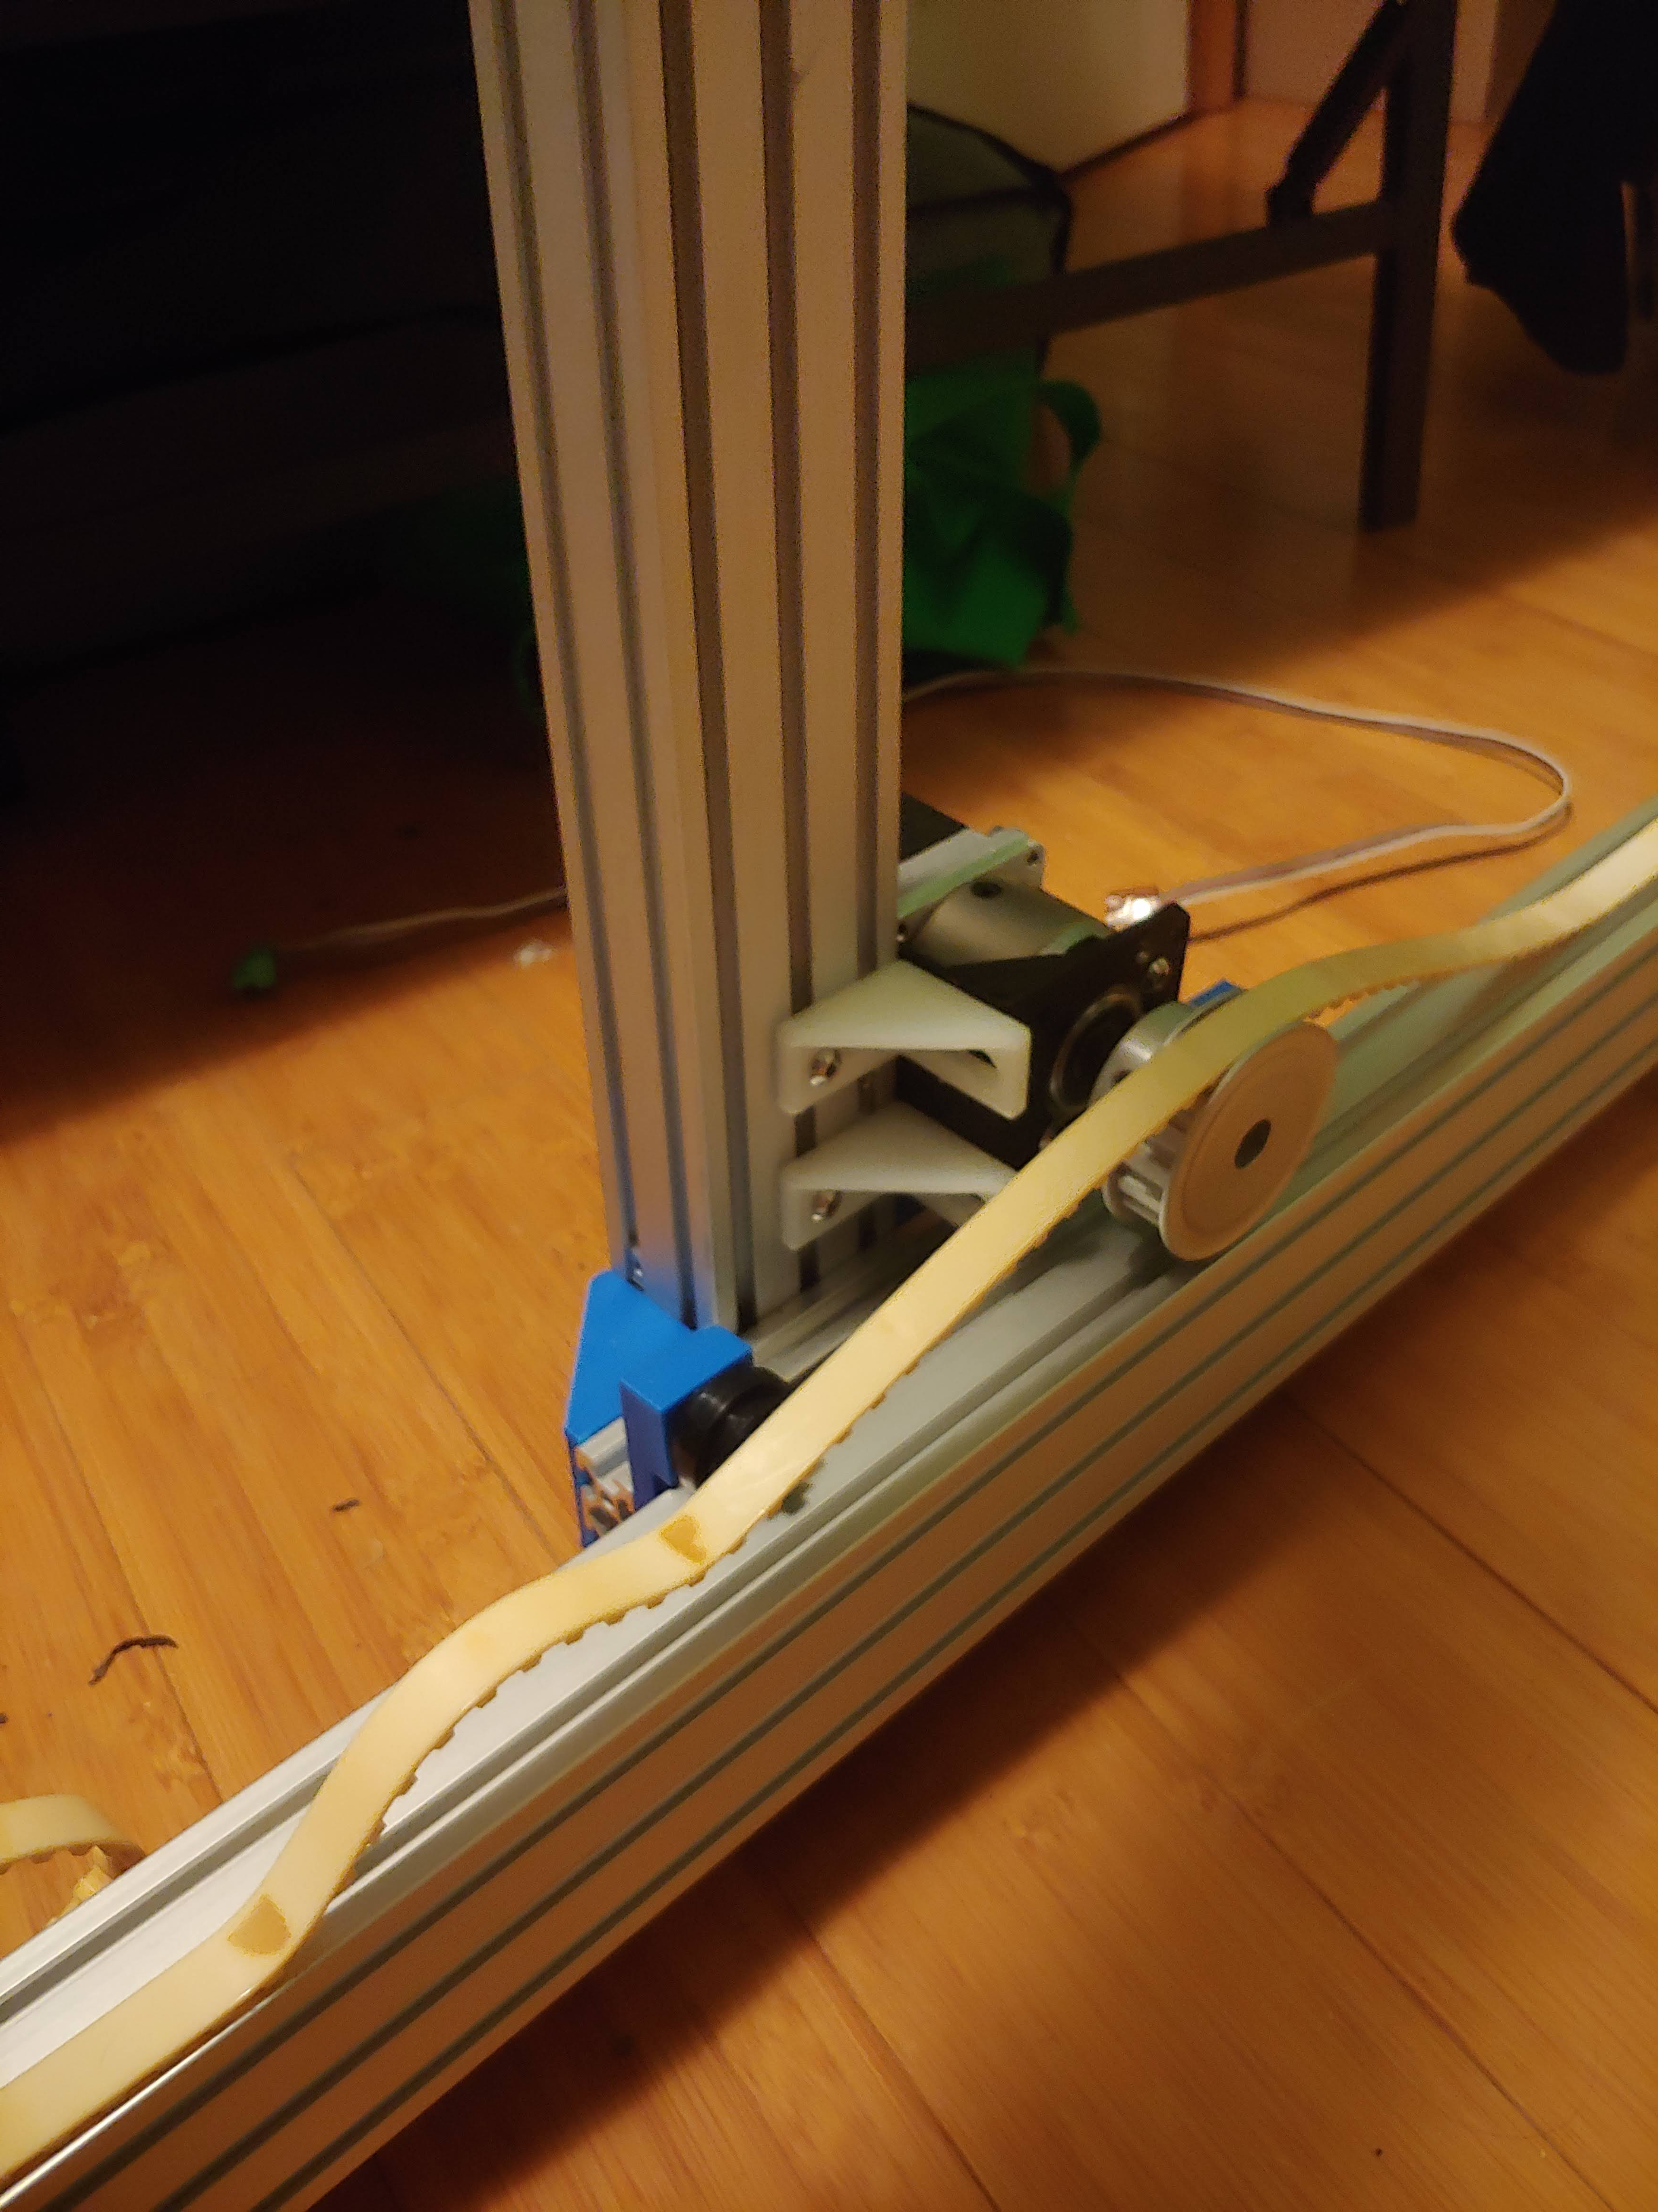
Current Status

Slide 4
Project Work
Junior Design Block 2 Checkoff
Met with Junior Design teams for the Checkoff
Teams still on track, some are having difficulty getting plans ready
Mostly issues getting PCB files ready for ordering and some design issues
3D Printing prototypes
Some printer issues, but mostly resolved
Still on track to have all parts printed by next week
Purchased some fasteners
Standardizing mounting fasters to M5
Got some better Tslot nuts for easy mounting

Slide 5
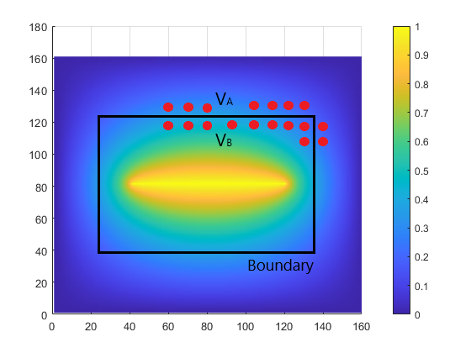
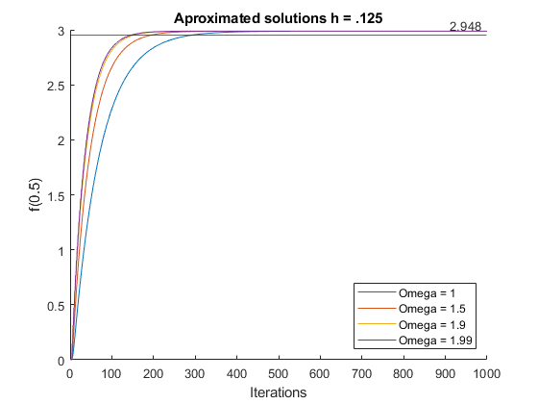
Other Work
Learning about Go and Concurrency in Distributed Systems
Lots of fun making asynchronous processes agree with each other
Finite Element Method and Spectral Domain Analysis in Adv Electromagnetics
Everything can be boiled down to estimating very small parts of a response and adding them all together
Lots of projects to keep up with

Slide 6
My Plan
Keep up with projects and school work
Assemble final parts of the HyperRail and start testing next week
Start working on optimized electrical design for Gantry Control

